Slide 1

Git
Version Control

Slide 2
Why
To keep track of the changes that you make as you develop the whole project!
Git is just a name of the program, you don’t have to care why. Invoke the command and the sub command to get the job done!

Slide 3
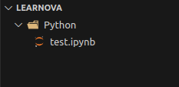
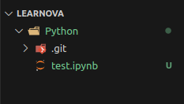
`git init`
You put your files in a directory
As you change, add on the files, how do you keep track of the changes?
Navigate to the `Python` (or your main folder), In the command line
`git init`
A hidden folder `.git` will be where the information about the changes is stored

Slide 4
Commit
When there is a change, git will record it as a ‘commit’
You have to manually add the changed files into a ‘staging’ phase
`git add .` #Add all files in the . (current directory)
Then, when you are satisfied that all the changes are significant enough to be packaged as a commit.
`git commit -m “description goes here” #Flag -m is for description
Changed files
staged files in staging
Package into a commit

Slide 5
Branch
As you add more changes to your files, more commits. There is a history chain of the commit that `git` will remember (stored in the .git folder)
Future commits…
Usually there is a main branch, which is the most stable, and agreed upon version
You can add another branch so that, you can try and develop new experimental features
Main branch
Experimental branch

Slide 6
Branching
Check what is your current branch: `git branch -v`
Create a new branch called “future-plans”: `git branch future-plans`
Switch to a different branch: `git checkout future-plans`
Then when you are in a new branch, you can continue to add commit in the experimental-branch-name branch without affecting the code in the main branch
Change, modify the files
Stage files
Add commits

Slide 7
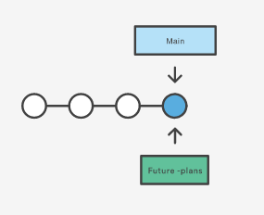
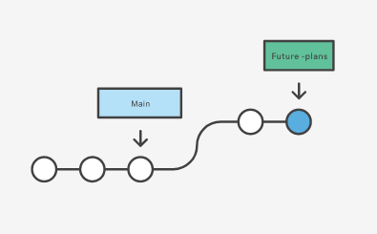
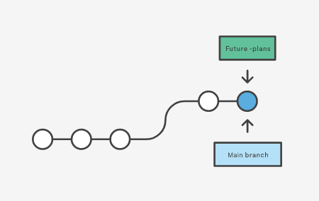
Merging
After you add many commits in the future-plans(to add feature, fix bugs), you can merge them back into the main
Now the “main” branch tracks the same sequence of commits as the “future-plans

Slide 8
Merging
Useful commands
Go to the main branch
`git checkout main`
Merge “future-plans” to “main”
`git merge future-plans` #We are currently at main branch
`git status`
Check out cheatsheets, advanced commands on tutorials

Slide 9
Remote and Local repo
Repo = repository = place to store the files
Remote repo refers to the place in the cloud, hosted online (Github)
Local repo refers to the place in your own computer

Slide 10
Software Development workflow in big team
When you collaborate in a big team, there is usually a team github and an official team repo
If the public wants to use your software, they go to the official team repo
Team github
Personal github
Official team github repo
Fork
Forked repo

Slide 11
Personal remote - local
Personal github
(Remote)
Forked repo
Personal laptop
(local)
Local repo
`git clone` or `git pull`
Depends on what you are doing, refer to cheatsheet

Slide 12
Personal remote - local
Personal github
(Remote)
Forked repo
Personal laptop
(local)
Local repo
`git push` to upload to remote
Make changes, making commits, branching, etc

Slide 13
Team github
Personal github
Pull request
(wait for approval)
Official team github repo
Forked repo
If the official team github repo has changed, do the same cycle! Fork the official, pull from remote, make changes, push to remote, pull request
Team github
Personal github
Official team github repo
Fork
Forked repo

Slide 14
Resources
Atlassian tutorial (with Bit Bucket) https://www.atlassian.com/git/tutorials/learn-git-with-bitbucket-cloud
Github Desktop https://desktop.github.com/
Git Cheatsheet https://education.github.com/git-cheat-sheet-education.pdf
Managing remote, local: https://docs.github.com/en/get-started/getting-started-with-git/managing-remote-repositories

